Slide 1
English 101
Week 2
This week’s theme: Life Balance

Slide 2
The Mexican Fisherman
Discuss answers

Slide 3
Contemplation experiment
For this experiment to work, you have to respect these conditions:
Remove all distractions (phones, books, TV, radio, etc.)
Turn lights down
Do not write, talk, or communicate in any way
Simply watch the video on full screen and do nothing. Keep your eyes on the screen

Slide 4
View this video for 4 minutes and then return
https://www.youtube.com/watch?v=yEn8_X7Ei3A

Slide 5
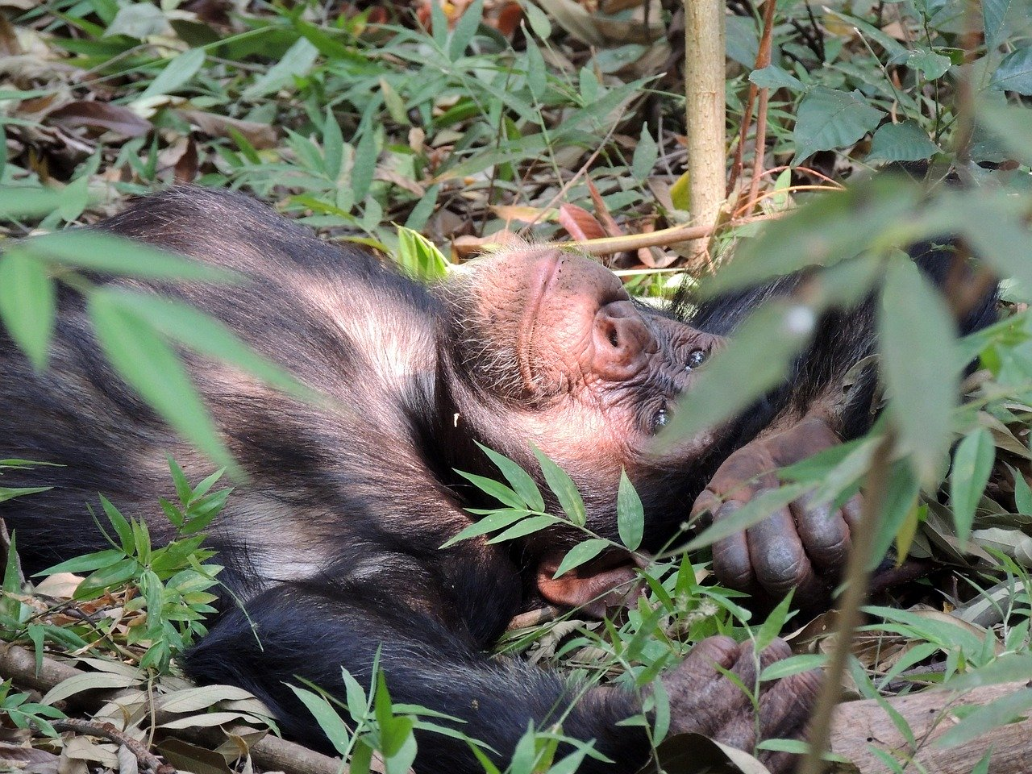
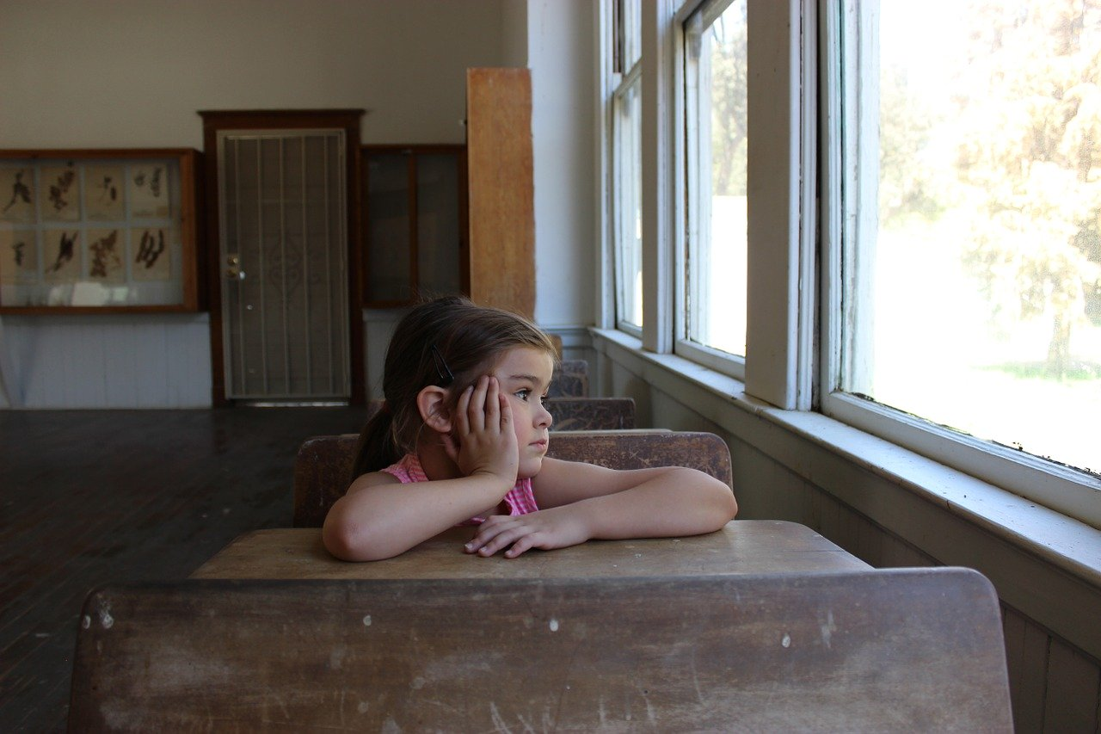
Vocabulary
Mind
Daydream
Disconnect

Slide 6
Reflection
In the chat, write answers to these questions:
Where did your mind go while you were watching the video?
What were your thoughts?
Were you able to disconnect and daydream?

Slide 7
Listening
You will now watch a video and answer questions. The language in this video is a little difficult. However, the message is simple.
Here is the procedure:
Review vocabulary on next slide
Review questions under “assignments”
Watch video
Answer questions
Return to ”general”

Slide 8
Listening
Learn this vocabulary:
Daydream
To stare – staring out the window
Wasted time
The high point
Mind
Insight
Reverie

Slide 9
Listening
Go to ”assignments,” read questions for “Daydreaming video, week 2”
Watch this video
Answer questions
Return to “general”

Slide 10
Reading an image with text
When your teacher says “Go”, join your team (channel) and do this:
Go to this web site and find this image:
Look at the images and read the text.
Summarize your understanding by writing down 5 complete sentences about things about a person who daydreams (“A daydreamer…”)
Return to “general” and write one of your sentences in the chat

Slide 11
Reading, writing and verbs
What verb tense did you use in your sentences?
Since you were stating facts, you probably used simple present.
Simple present is used for stating facts, describing something, talking about a routine, etc. Here is a good website to refer to.

Slide 12
Reading, writing and verbs
The last activity in today’s class requires you to read a text and then do a task with the information.
You should do this task with a partner

Slide 13
Reading text 2
Procedure:
Read this text
Highlight or write down all vocabulary that is new to you. This is a good dictionary.
Be sure you understand the general idea and most of the details.
In your portfolios, write a short dialogue in which your friend asks you about daydreaming and you answer with information from the text. Be sure to give three reasons in your answer.
Double check your use of language. If you are stating facts, you will probably use simple present.

Slide 14
Dialogue
This is what a dialogue looks like:
Christi: “Hi, Julia, I’m in a bit of a bad state! Can you help? I’m feeling stressed.”
Julia: “Oh hi, Christi. I’m sorry to hear that. When did this start?”
Christi: …..

Slide 15
Homework
Before next class do this homework:
Grab your smartphone and take a w,alk in nature (a park, a lake, a forest, the shores of the river, a field).
When you notice some element of nature that captures your attention, take a photo of it.
Continue your walk for as long as you can
Upload your photo to your portfolio with these explanations:
What this photo means to you
All the steps you took to get that photo into your portfolio

